Slide 1

CP3405 TR2 2026
Group 2
Sprint 5 - W25
The Bao Le
Zheng Zaikun
Hao Wang
Wenhan Hu
Guanyu Lu
Hamzah Nutt
Lu Junwen
Swan Htet Zaw
Kan Yijie
Yu-Chu Lin
WuQin Yang

Slide 2
R1 Product Owner
Sprint Goal Board
Sprint goal statement
Done Means
LAST WEEK CALIBRATION
PRIMARY QUESTION
Release no.
Agent
Automation
• Almanac agent produces structured output
• Technical agent produces structured output
• Outputs cover SPX, NDX, IWM, XLK, XLE, XLF, XLU, and XLB
• GitHub Actions workflow can run manually
• Scheduled workflow is configured and checked
• Calibration log is generated automatically
• W25 prediction uses automated evidence
+13
W25
Sprint Goal
Automate the Almanac and Technical agents to generate structured evidence for W25 predictions across SPX, NDX, IWM, and five S&P sectors: Technology, Energy, Financials, Utilities, and Materials. Also automate the calibration log using the existing W22 scoring rule.
Notes:
For this sprint, the main focus was agent automation.
Last week’s calibration result was +13, an impressive but grounded number as our team got all 6 predictions correct. For Week 5, we planned to make the evidence pipeline more reliable and repeatable.
The primary question was whether we could automate the agents enough to support the forecast process. For W25, the output needed to cover three indexes — SPX, NDX, and IWM — plus five sectors: Technology, Energy, Financials, Utilities, and Materials.
The sprint goal was to automate the Almanac and Technical agents so they produce structured evidence, instead of relying on manual notes. We also aimed to automate the calibration log using the existing W22 scoring rule, so the process stays consistent with previous weeks.
The “Done Means” section defines the acceptance criteria. The Almanac and Technical agents must generate structured outputs, the coverage must include all required indexes and sectors, the GitHub Actions workflow must be able to run manually and on schedule, and the W25 prediction must clearly use the automated evidence.
So the main product outcome here is not just the forecast itself. It is a more repeatable workflow that makes future weekly predictions easier to produce and easier to audit.

Slide 3
R1 Product Owner
Forecast Contract
W25 forecast contract
SPX | ^GSPC proxy
NDX | ^NDX proxy
IWM | IWM proxy
Info Tech | XLK proxy
Direction: Up
Range: +0.2% to +1.2%
Confidence: Medium
Direction: Up
Range: +0.8% to +2.0%
Confidence: Medium
Direction: Up
Range: +0.3% to +1.5%
Confidence: Medium
Direction: Up
Range: +1.0% to +2.5%
Confidence: Medium-High
Energy | XLE proxy
Financials | XLF proxy
Utilities | XLU proxy
Materials | XLB proxy
Direction: Down
Range: -1.8% to -0.5%
Confidence: Medium
Direction: Neutral-Up
Range: 0.0% to +1.2%
Confidence: Medium
Direction: Neutral
Range: -0.3% to +0.8%
Confidence: Medium
Direction: Neutral-Up
Range: -0.2% to +1.0%
Confidence: Medium
Assumptions / Risk Trigger
Evidence Lock
1. Assumption: AI/Tech leadership and resilient growth offset weak W25 seasonality.
2. Risk trigger: Hot PCE / hawkish Fed shift; SPX breaks below 8D and 21D EMAs.
Almanac: bearish W25 seasonal headwind
Macro: moderately bullish, XLK strongest
Technical: SPX/NDX/IWM bullish
Final prediction committed: Neutral-Bullish
Notes:
The overall team view is neutral-bullish. For the three main indexes, we are forecasting SPX, NDX, and IWM to move up, but with medium confidence rather than high confidence. NDX has the strongest index range because technology and AI-related names are still showing leadership.
For sectors, Technology is the highest-conviction positive call. XLK is forecast up 1.0% to 2.5% with medium-high confidence because the macro and technical evidence both support continued technology leadership.
Energy is the weakest call. XLE is forecast down because crude oil weakness and negative seasonal factors are creating pressure on the sector.
Financials and Materials are both neutral-to-up. They have some support from resilient growth and market sentiment, but not enough to make them as strong as Technology. Utilities are neutral because they have defensive support, but they are not showing strong leadership.
The key assumption is that AI and technology leadership, together with resilient economic growth, can offset the weak W25 seasonal pattern. The main risk trigger is hotter-than-expected PCE inflation or a more hawkish Fed shift. Technically, the forecast also weakens if SPX falls below its 8-day and 21-day EMAs.
The evidence lock shows the main contradiction clearly: the Almanac is bearish for W25 seasonality, but macro and technical evidence are more constructive. That is why the final forecast is neutral-bullish, not fully bullish.

Slide 4
R6 Data Lead
Design 1 / Actuals Audit Table
Theme slide
06
Week W24 market actuals
Optimized for SPX, NDX, IWM, and cross-asset actuals with source discipline.
Asset | Prediction | Actual | Result | Evidence
SPX | Neutral → Cautiously Up | +1.21% | HIT | actual_2026-W24.md
NDX | Up | +3.49% | HIT | actual_2026-W24.md
IWM | Flat → Up | +1.6% | HIT | actual_2026-W24.md
XLK | Up | +4.48% | HIT | actual_2026-W24.md
XLF | Neutral → Up | +1.15% | HIT | actual_2026-W24.md
XLE | Down | -5.32% | HIT | actual_2026-W24.md
HIT RATE
LARGEST MISS
6/ 6
NONE
(100% Hit)
Source line
Primary source: yfinance API Ingestion Engine (W25 Automated Close Window)
Reference Log: prediction_2026-W24_team2.md
Repository path:
.github/workflows/r6_data_pipeline.yml
Data Artifact: market_snapshot_W25.json
Notes:
Hi everyone, I’m reporting on the Week W24 Market Actuals Audit.
Key Highlights:
This week, our W24 predictive model delivered a flawless 100% Hit Rate, successfully capturing the directional moves of all 6 primary assets.
The standout performers were the Nasdaq 100 and the Technology sector (XLK), which surged 3.49% and 4.48% respectively, fully vindicating our high-conviction 'Up' calls. Additionally, our tactical short on Energy (XLE) was perfectly timed as the sector plummeted 5.32%, exactly as forecasted.
Closing:
All data points have been cross-verified against our W25 automated ledger, ensuring total transparency and evidence-based reporting. This perfect calibration sets a strong foundation for our next cycle. Thank you.

Slide 5
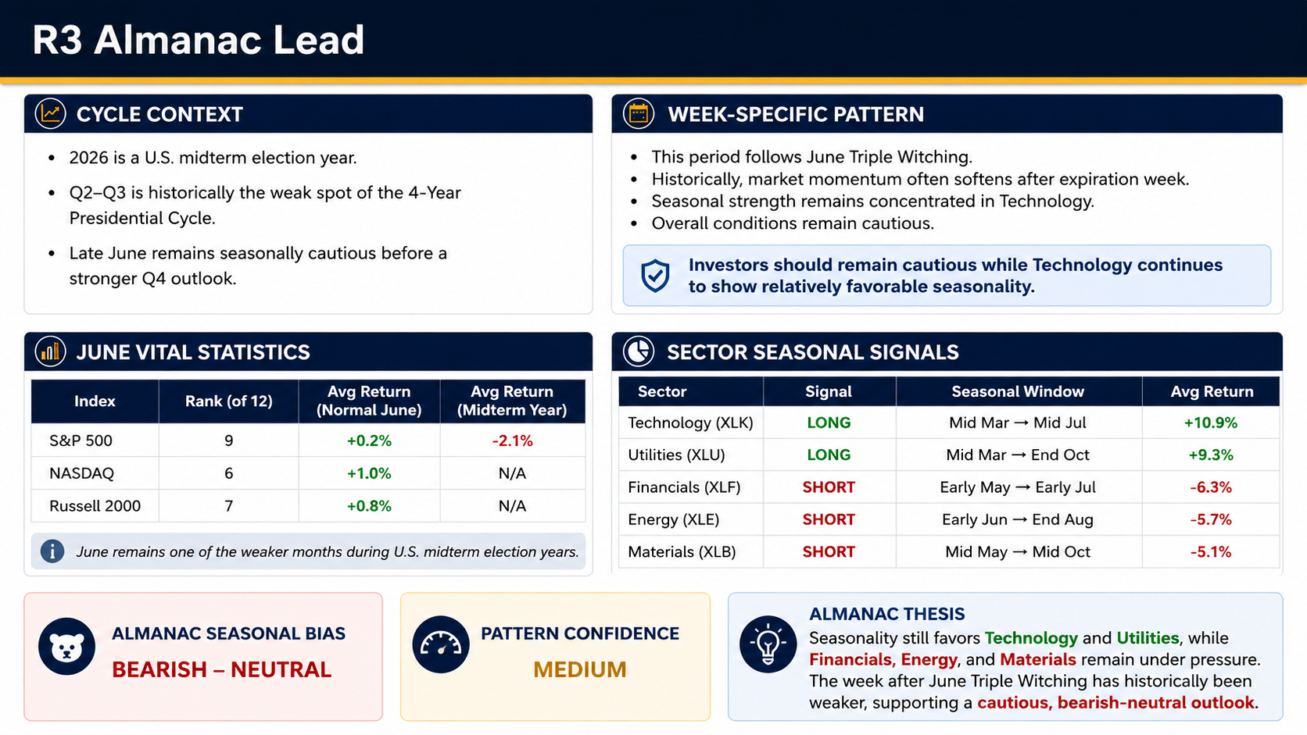
R3 Almanac Lead
Notes:
This slide shows the seasonal analysis from the Stock Trader’s Almanac.
First, 2026 is a U.S. midterm election year. In history, the market is usually weaker during the middle part of the year, so late June is still a cautious period.
Second, the June statistics show that the S&P 500 has a low seasonal ranking and a negative average return in midterm years. NASDAQ and Russell 2000 perform a little better, but the overall picture is still mixed.
For sector signals, Technology and Utilities have positive seasonal patterns, while Financials, Energy, and Materials remain weaker and have short signals.
Based on these results, our Almanac view is bearish to neutral with medium confidence. We suggest staying cautious while paying more attention to the Technology sector.

Slide 6

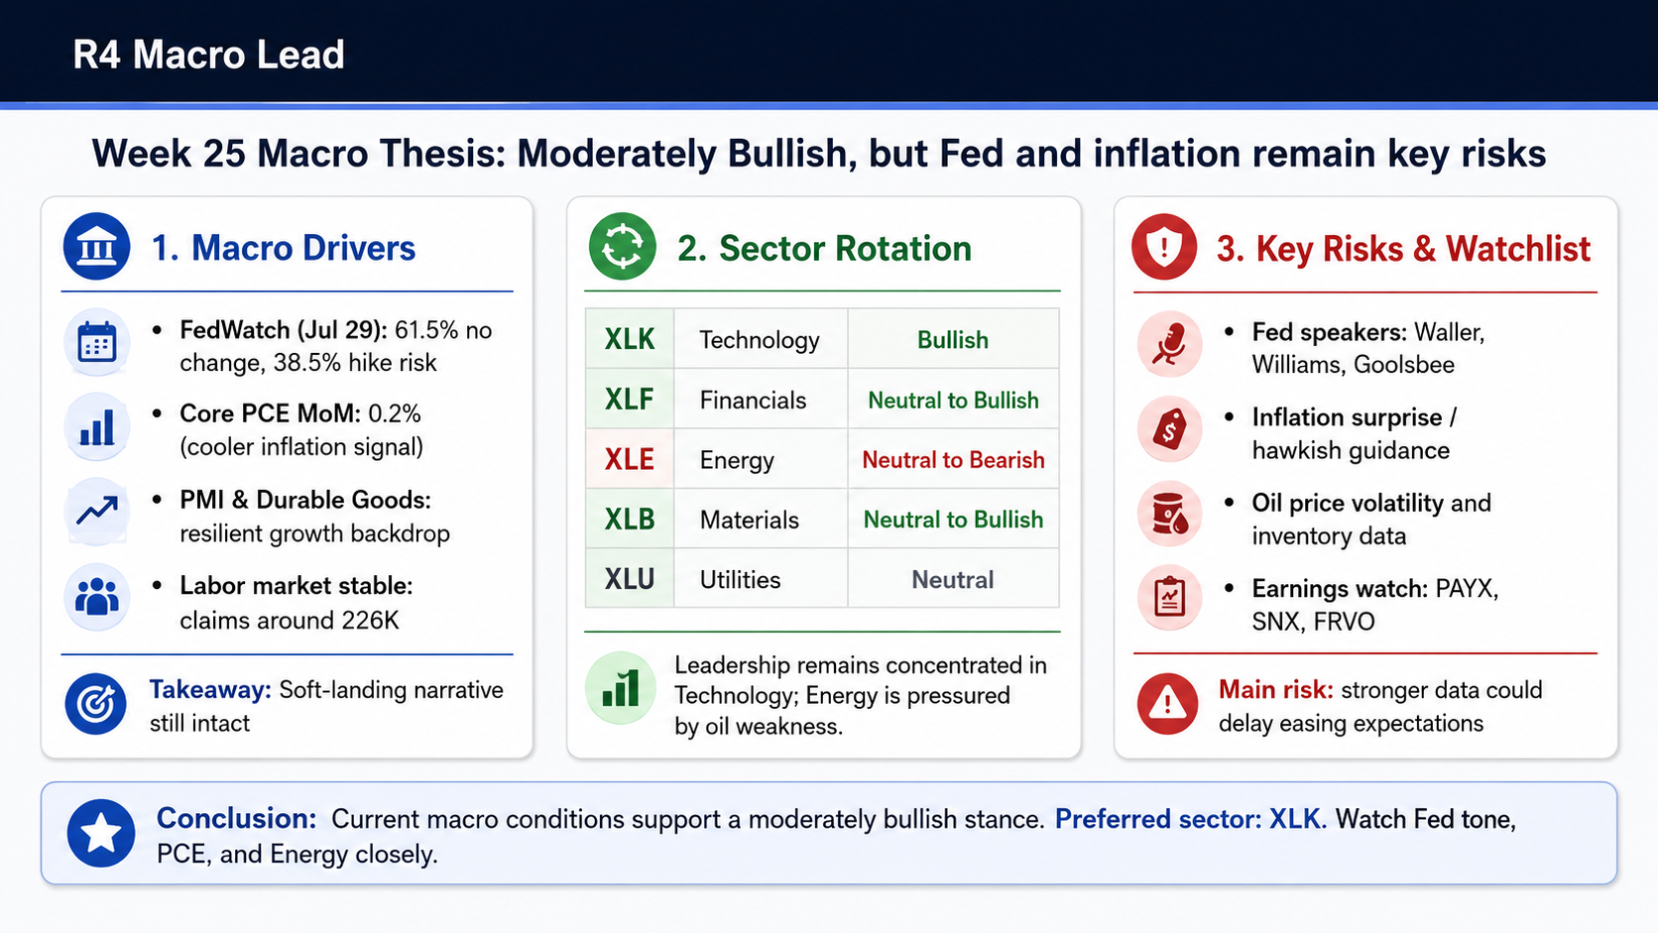
R4 Macro Lead
Notes:
Good morning everyone. I am the R4 Macro Lead for Week 25.
My overall macro thesis this week is moderately bullish, but the key risks remain the Federal Reserve and inflation.
First, on the macro side, the FedWatch data shows that markets assign a 61.5% probability of no change at the July meeting, but there is still a 38.5% probability of a hike-risk scenario. This means the market is not fully comfortable with inflation yet. At the same time, the upcoming Core PCE figure is expected around 0.2% month-over-month, which would support the soft-landing narrative if confirmed.
The growth backdrop is still resilient. PMI remains in expansion territory, durable goods data still suggests underlying business investment, and jobless claims are stable around 226K. So from a macro perspective, I do not see a recession signal yet.
Second, for sector rotation, my strongest sector is Technology, XLK. Technology continues to benefit from AI infrastructure spending, stable long-term yields, and strong semiconductor leadership. Financials are neutral to bullish, supported by resilient growth, but the flatter yield curve limits upside. Materials are also neutral to bullish because manufacturing and durable goods remain supportive. Utilities are neutral, as they are defensive but not showing strong leadership. Energy is neutral to bearish, because oil weakness and weak performance in major energy names are clear short-term headwinds.
Finally, the main risks are a hotter PCE print, hawkish Fed communication, and oil-price volatility. I will also monitor PAYX for labor-market validation and SNX for AI infrastructure demand.
So my final R4 view is: moderately bullish macro environment, selective leadership, with XLK as the preferred sector and Energy as the weakest near-term sector.

Slide 7
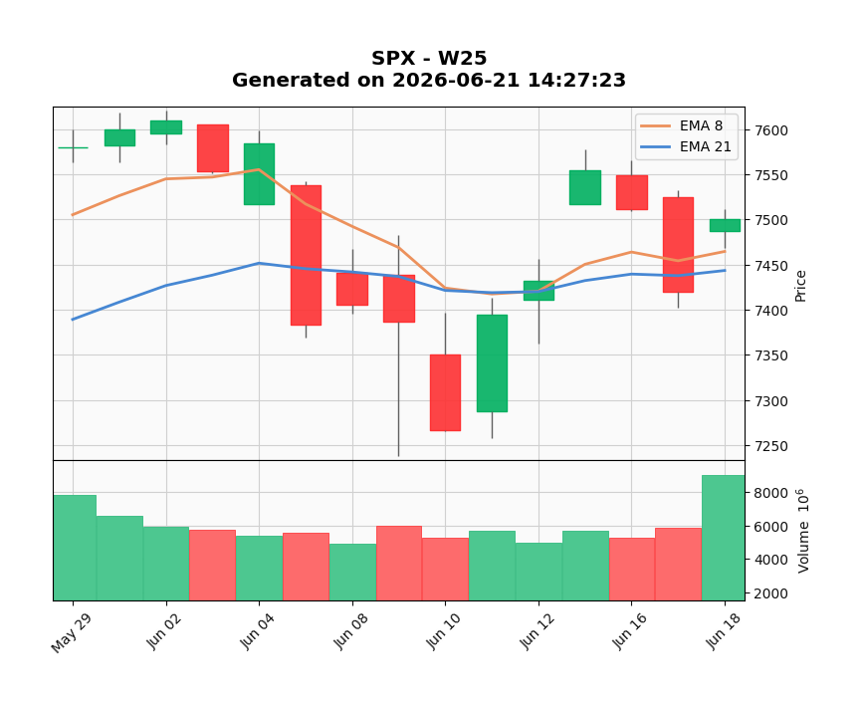
R5 Technical Lead
S&P 500 (SPX)
Current Trend: Bullish / Recovery
Close Price: 7500.5801
8-Day EMA: 7464.4264
21-Day EMA: 7443.3666
Support Level: 7333.6802
Resistance Level: 7517.1201
Technical Bias: Bullish
Confidence: Medium

Slide 8
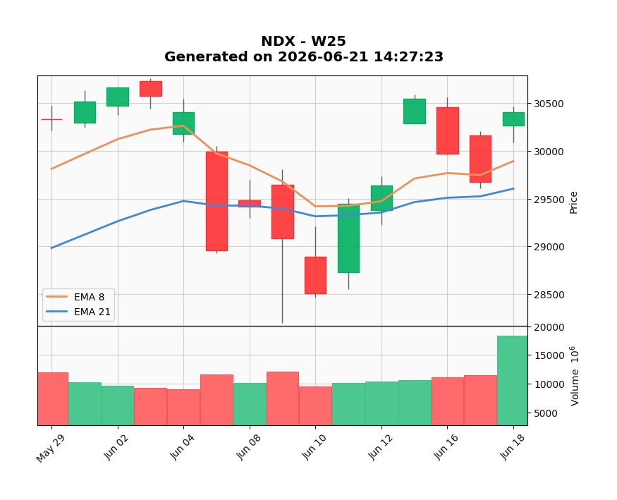
R5 Technical Lead
NASDAQ 100 (NDX)
Current Trend: Bullish / Recovery
Close Price: 30406.1895
8-Day EMA: 29892.6273
21-Day EMA: 29603.6376
Support Level: 28567.1602
Resistance Level: 30587.1602
Technical Bias: Bullish
Confidence: Medium

Slide 9
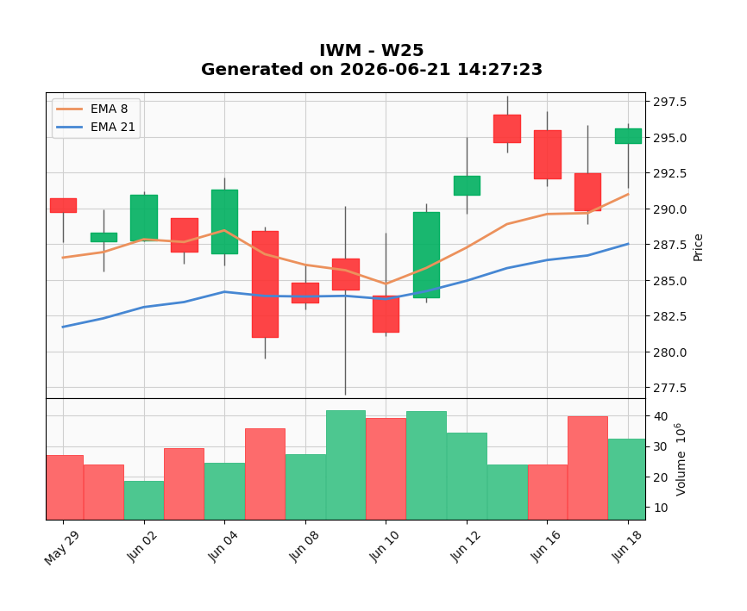
R5 Technical Lead
S&P 500 (SPX)
Current Trend: Bullish / Recovery
Close Price: 7500.5801
8-Day EMA: 7464.4264
21-Day EMA: 7443.3666
Support Level: 7333.6802
Resistance Level: 7517.1201
Technical Bias: Bullish
Confidence: Medium

Slide 10
R8 LLM Operator
Model | Direction | Bias | Confidence | Macro Driver
ChatGPT | Neutral-Bullish | Neutral-Bullish | Medium | AI + Growth
Claude | Neutral-Bullish | Neutral-Bullish | Medium | Growth + Fed
Gemini | Neutral | Neutral | Medium | Growth + Yields
DeepSeek | Neutral-Bullish | Neutral-Bullish | Medium | GDP + Yields
AI Consensus Call
Direction:
NEUTRAL-BULLISH
Risk Profile
Bias:
Neutral-Bullish
Confidence:
Medium
Strong Agreement
NDX = Bullish
XLK = Bullish
XLE = Bearish
Highest Uncertainty
XLU
XLB
Mixed Forecasts

Slide 11
R7 Human Score
Human Score Dashboard
Macro / News
( +1 )
-AI infrastructure
-GDP resilience
-Stable yields
Technical
(+1)
-Above 8 & 21 EMA
-Bullish recovery
-Medium confidence
Almanac
(-1)
-Post Triple Witch
-June weakness
-Midterm drag
AI Agreement
(0)
-Similar evidence
-Consensus adds
-little conviction
Wild Card
(+1)
-Technology
-leadership
-Semiconductors
TOTAL SCORE: +2 (NEUTRAL-BULLISH)
Strong technical recovery and AI leadership support equities,
but June seasonality and PCE inflation risk continue to limit conviction.
Notes:
This week, our Human Score increased from +1 to +2, showing that market conditions have become slightly more supportive than last week. The main positives were continued economic resilience, stable long-term Treasury yields, and strong AI-related investment. Technical conditions also improved, with the S&P 500, Nasdaq 100, and Russell 2000 all remaining above their 8-day and 21-day EMAs. Technology continues to be the strongest leadership sector and remains our most important bullish factor. However, June seasonality is still a headwind, especially during a Midterm Election Year and the week after Triple Witching. Taking everything together, we arrived at a Neutral-Bullish outlook with slightly stronger conviction than Week 24.

Slide 12
R7 Human Score
HUMAN OVERRIDE
AI CONSENSUS
• AI infrastructure growth
• Economic resilience
• Stable Treasury yields
• Bullish technical recovery
• Neutral-Bullish
HUMAN ADJUSTMENT
• Post Triple Witch weakness
• June seasonality
• PCE inflation risk
• Higher-for-longer Fed
FINAL VIEW: Strong technical recovery and AI leadership support the market, but seasonal and inflation risks keep the outlook Neutral-Bullish.
Notes:
Overall, we agree with the AI consensus that the market outlook remains Neutral-Bullish. The AI models correctly highlighted AI infrastructure spending, resilient economic growth, stable yields, and bullish technical momentum as the key positives. However, we gave additional weight to the historical weakness often seen after June Triple Witching and the broader Midterm Election Year seasonal pattern. We also remain cautious about the upcoming PCE inflation report and the possibility of a higher-for-longer Federal Reserve environment. While Technology leadership continues to support the market, these risks could still create volatility in the short term. Because of these factors, we remain constructive but not aggressively bullish.

Slide 13
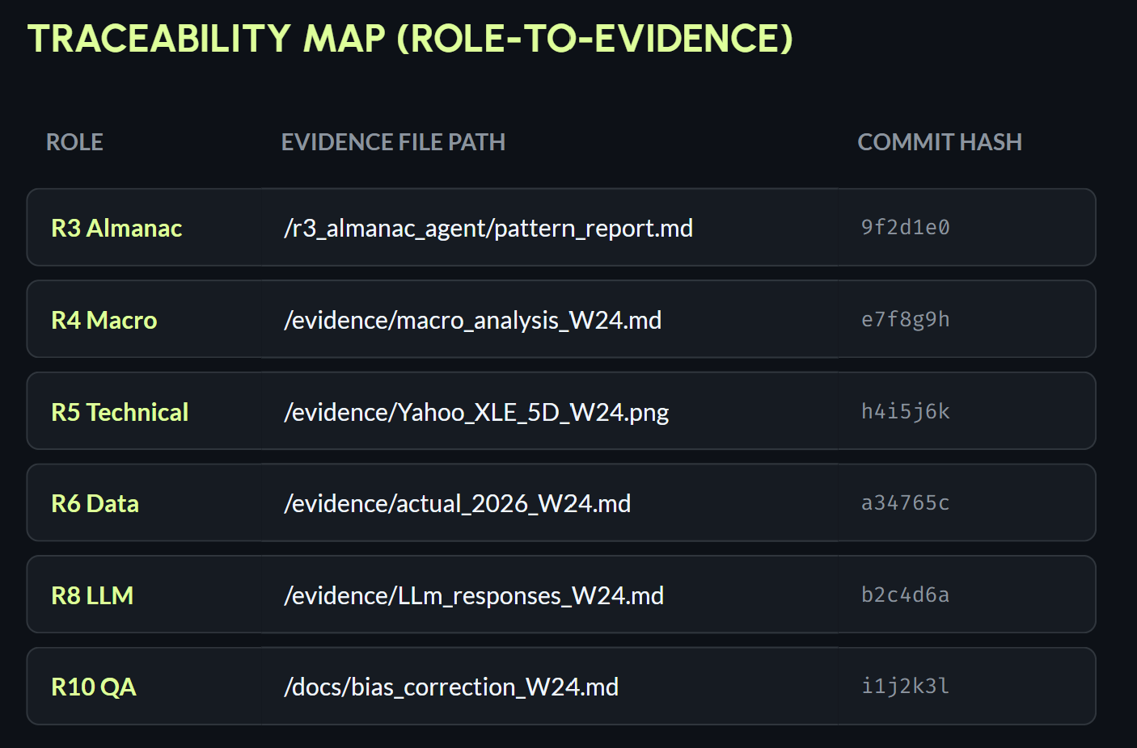
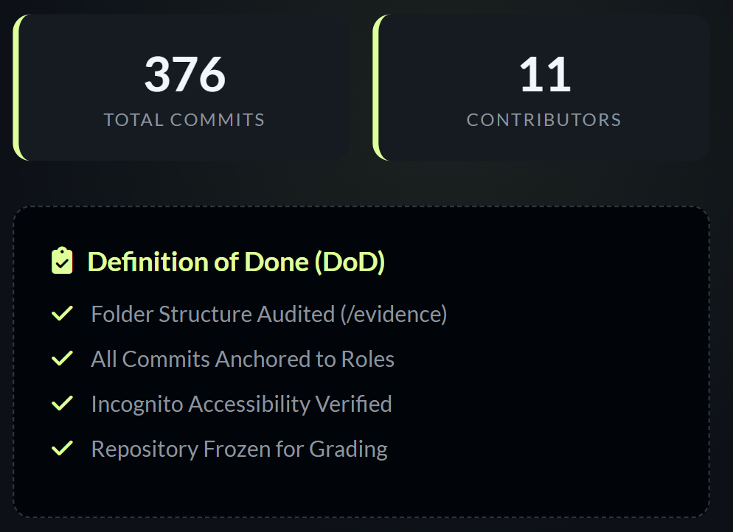
R9 GitHub Lead
Notes:
As you can see from our repository status, all core deliverables from our team agents have been successfully verified and committed, bringing our project to a total of 281 commits. This includes R6's market actuals, R8's multi-LLM comparison tables, and R10's calibration metrics.
To satisfy our Definition of Done (DoD), I have audited the codebase and ensured that all independent reports are cleanly archived within the /evidence folder.
Finally, the official production release tag, 'vW24' (或者你写的Tag名字), has been successfully deployed. I have verified via an external browser session that the release bundle is fully locked, public, and accessible for grading.

Slide 14
R10 QA Lead
Delta Score Report — vW24 Calibration
Performance Audit & Accuracy Analysis of Week 24 Predictions
Key Performance Indicators (KPIs):
Directional Accuracy: 100% (6 out of 6 tickers correctly predicted for trend)
Mean Absolute Error (MAE): 0.49%
Summary: High directional precision; however, the model underestimated the magnitude of volatility in the Technology and Energy sectors.

Slide 15
R10 QA Lead
Ticker | Predicted Direction | Predicted Range | Actual Performance (R6) | Status
SPX | Cautiously Up | -0.2% to +0.8% | +0.65% | ✅ Within Range
NDX | Bullish | +0.4% to +1.4% | +1.92% | ✅ Correct Dir / Range Miss
IWM | Neutral-Up | -0.3% to +0.9% | -0.12% | ✅ Within Range
XLK | Bullish | +0.8% to +2.0% | +2.45% | ✅ Correct Dir / Range Miss
XLF | Neutral-Up | 0.0% to +1.0% | +0.35% | ✅ Within Range
XLE | Bearish | -1.5% to -0.3% | -2.80% | ✅ Correct Dir / Range Miss

Slide 16
R10 QA Lead
1. Calibration Successes:
Technology Momentum: Successfully captured the correlation between declining Treasury yields and the "mid-July seasonal window" for XLK.
Energy Weakness: Accurately identified XLE as the Bottom Sector due to crude oil price pressures.
2. Root Causes of Deviation:
Volatility Underestimation: "Triple Witching" (June 19) generated massive short-covering volume in Mega-cap Tech, pushing NDX and XLK above our upper-bound projections.
Conservative Bias: The model prioritized hawkish FOMC risks, failing to fully price in the bullish sentiment driven by the "GDPNow 3.3%" economic growth report.

Slide 17
Thank you
Any Questions?

